Slide 1

Prescriptive Process: What the team needs to do
Instructions
Templates
Required Signoffs
Feedback Process: How to tell it was done well
Peer Reviews
Design of Experiments (DOE)
Customer Validation
Prescription + Feedback = Comprehensive Process

Slide 2
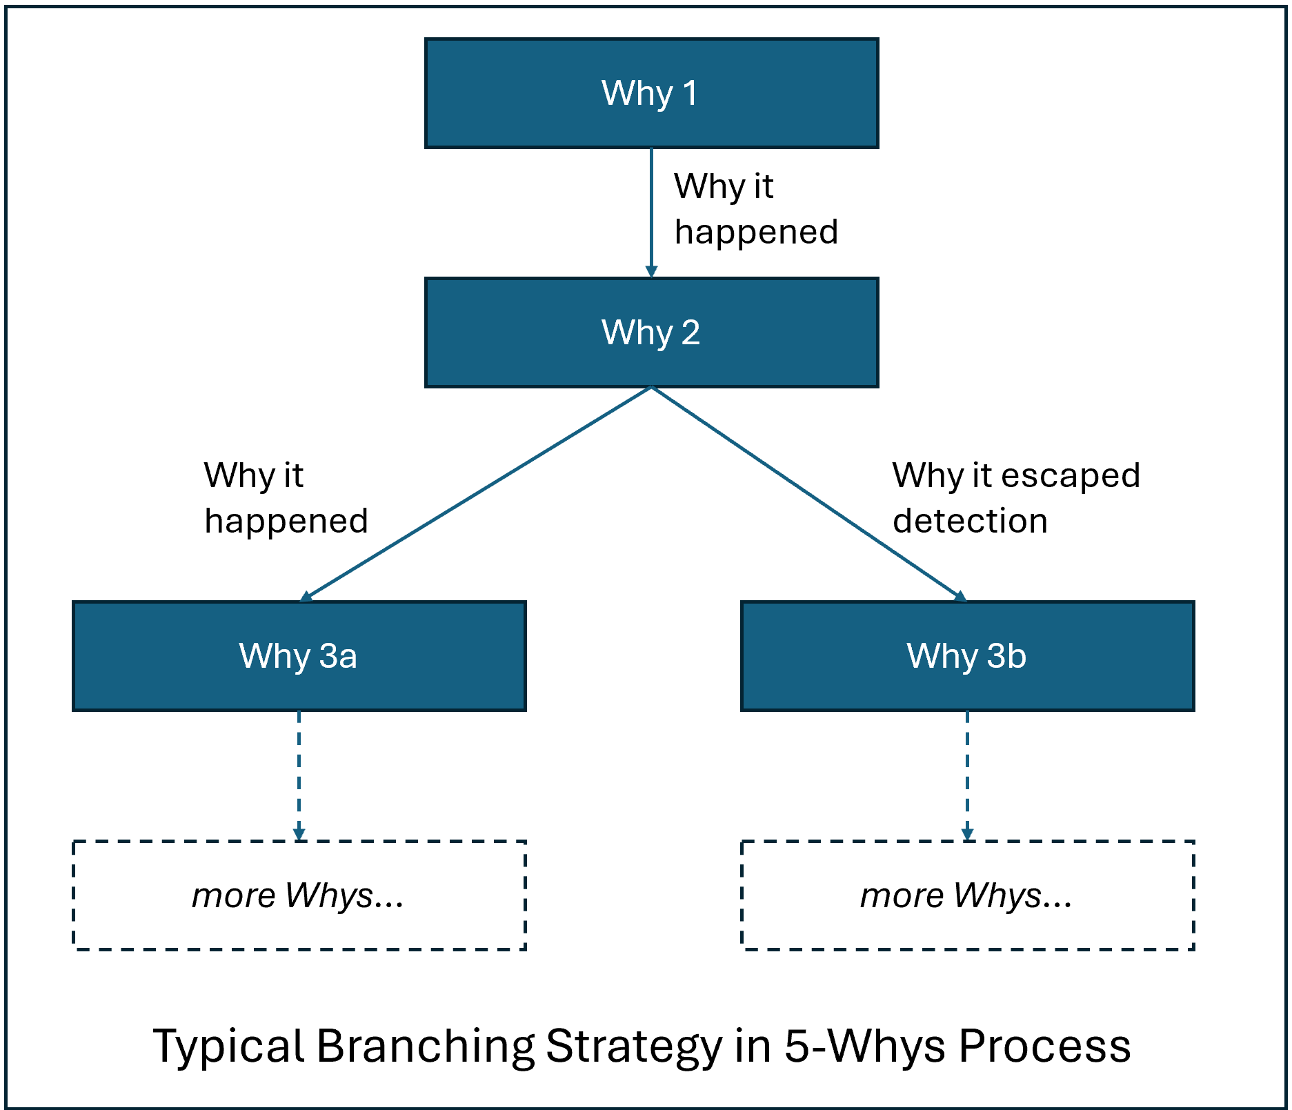
Why 1
Why it happened
Why 2
Why it happened
Why it escaped detection
Why 3a
Why 3b
more Whys…
more Whys…
Typical Branching Strategy in 5-Whys Process

Slide 3
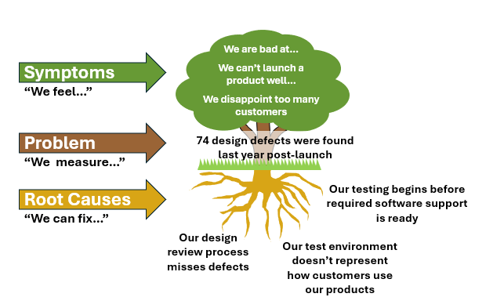
We are bad at…
We can’t launch a product well…
We disappoint too many customers
Symptoms
“We feel…”
Problem
“We measure…”
74 design defects were found last year post-launch
Root Causes
“We can fix…”
Our testing begins before required software support is ready
Our design review process misses defects
Our test environment doesn’t represent how customers use our products

